Slide 1

Micro Credit Defaulter Analysis
Submitted by:
Priyanka Yadav

Slide 2
Introduction
We are been given dataset of fixed wireless telecommunications network provider. They have launched various products and have developed its business and organization based on the budget operator model, offering better products at Lower Prices to all value conscious customers through a strategy of disruptive innovation that focuses on the subscriber. They understand the importance of communication and how it affects a person’s life, thus, focusing on providing their services and products to low income families and poor customers that can help them in the need of hour. They are collaborating with an MFI to provide micro-credit on mobile balances to be paid back in 5 days. The Consumer is believed to be defaulter if he deviates from the path of paying back the loaned amount within the time duration of 5 days. For the loan amount of 5 (in Indonesian Rupiah), payback amount should be 6 (in Indonesian Rupiah), while, for the loan amount of 10 (in Indonesian Rupiah), the payback amount should be 12 (in Indonesian Rupiah).
Objective of the study is to learn the behaviour of defaulters as well as prepare a machine learning model to classify all defaulters using the sample dataset provided by the client

Slide 3
Dataset and Features
About the datasets
Data was been provided to me by FlipRobo Technologies. Whereas originally data belongs to an Indonesian Telecom Company. The data contains 34 columns and 209583 entries.
Features

Slide 4
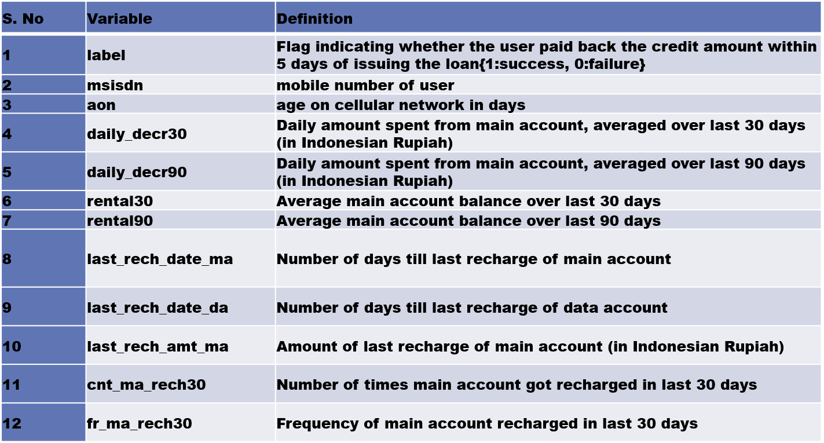

Slide 5
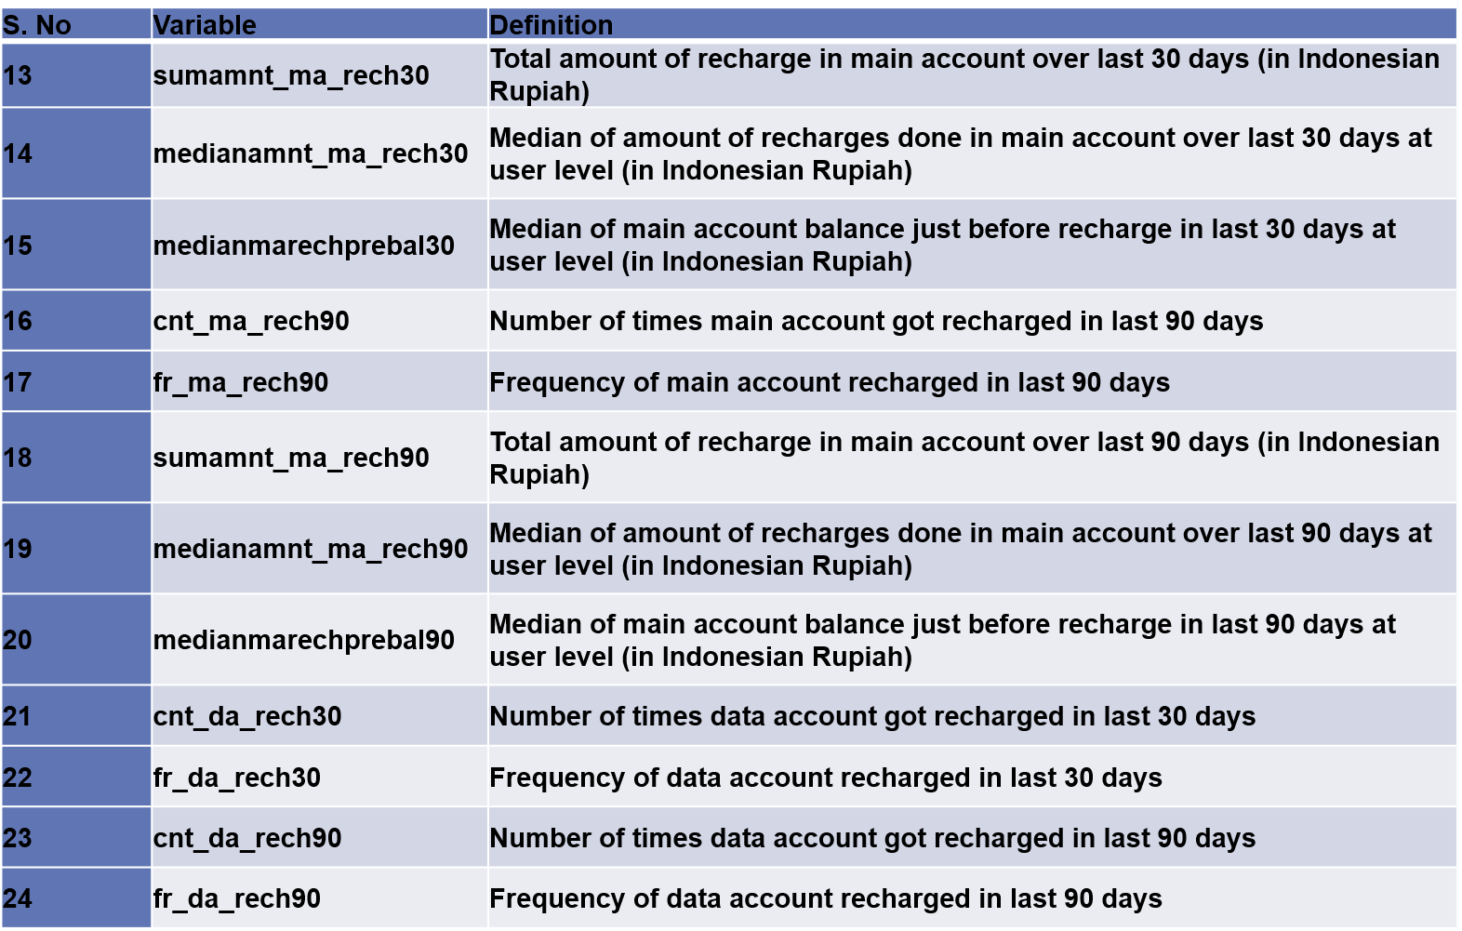

Slide 6
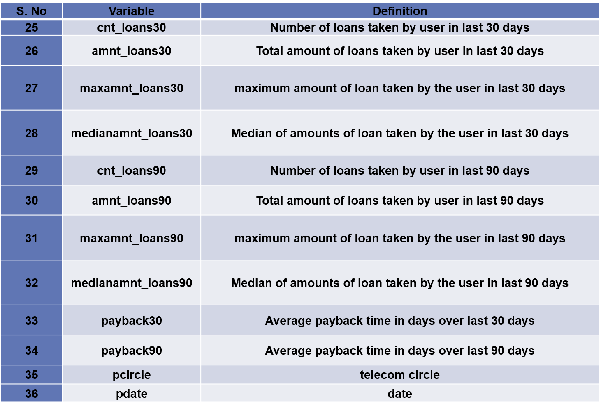

Slide 7
Data Pre-Processing & Cleansing
For keeping the only the useful data we used feature engineering. We removed the data if unnecessary by qualifying them on certain conditions like their uniqueness, their correlation with target variable and the no of outliers present in that particular variable.
We then tried the change the data into the form they belong to either by changing their type or by bifurcating the complex variables.
We also tried to treat the outliers and skewness present in the data.
We also scaled the data so that the data is standardized.

Slide 8
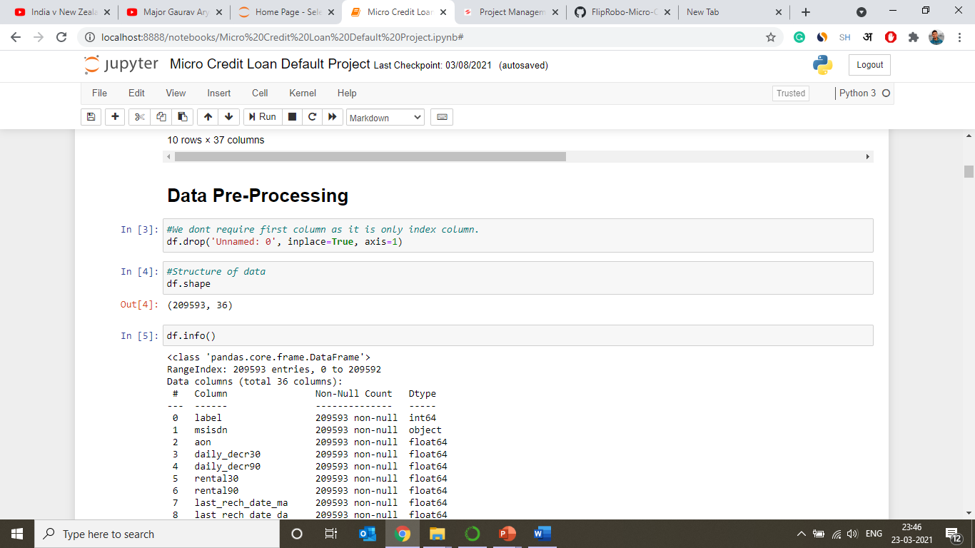
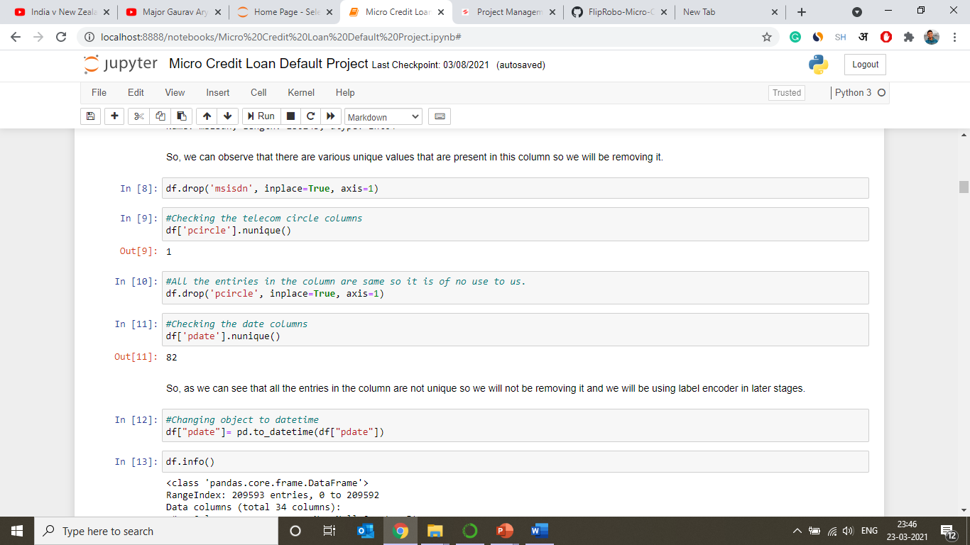

Slide 9
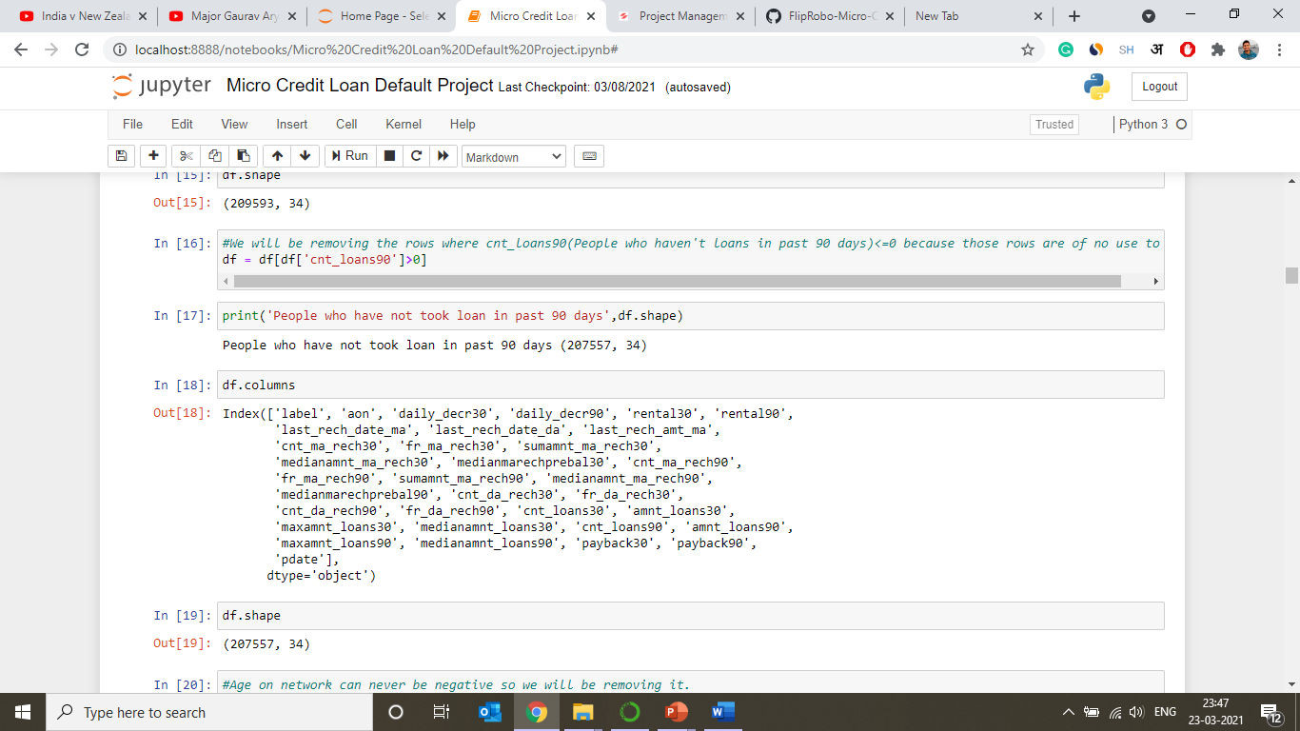
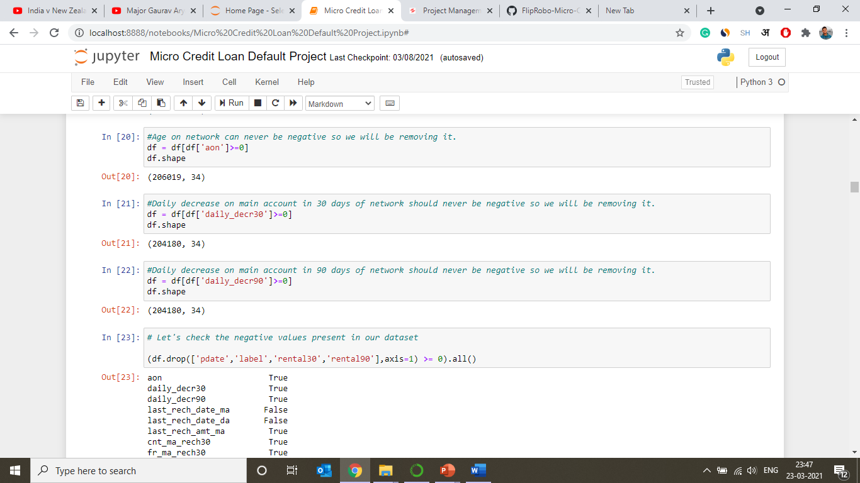

Slide 10
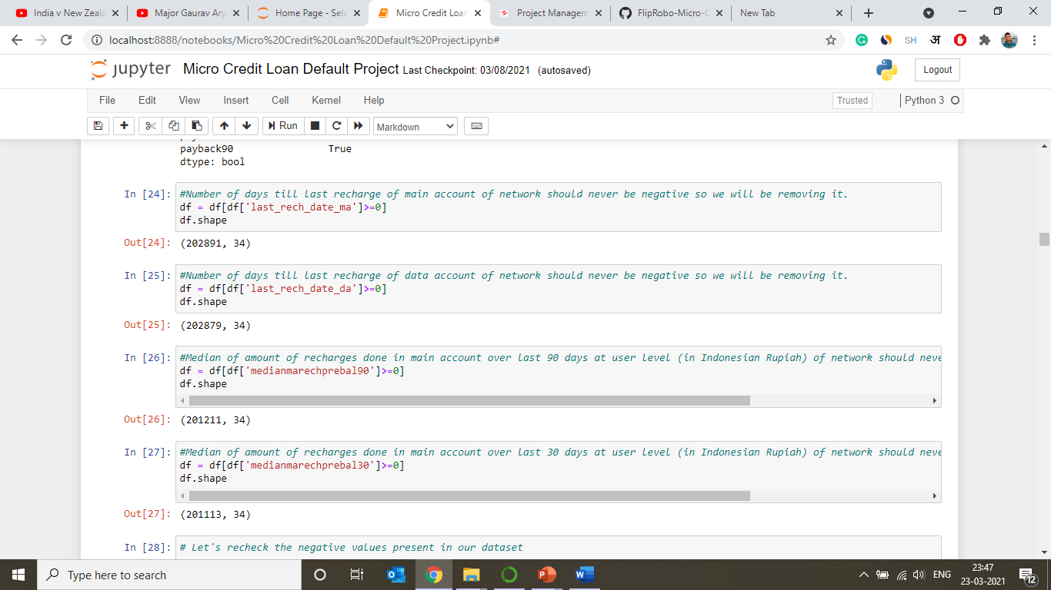
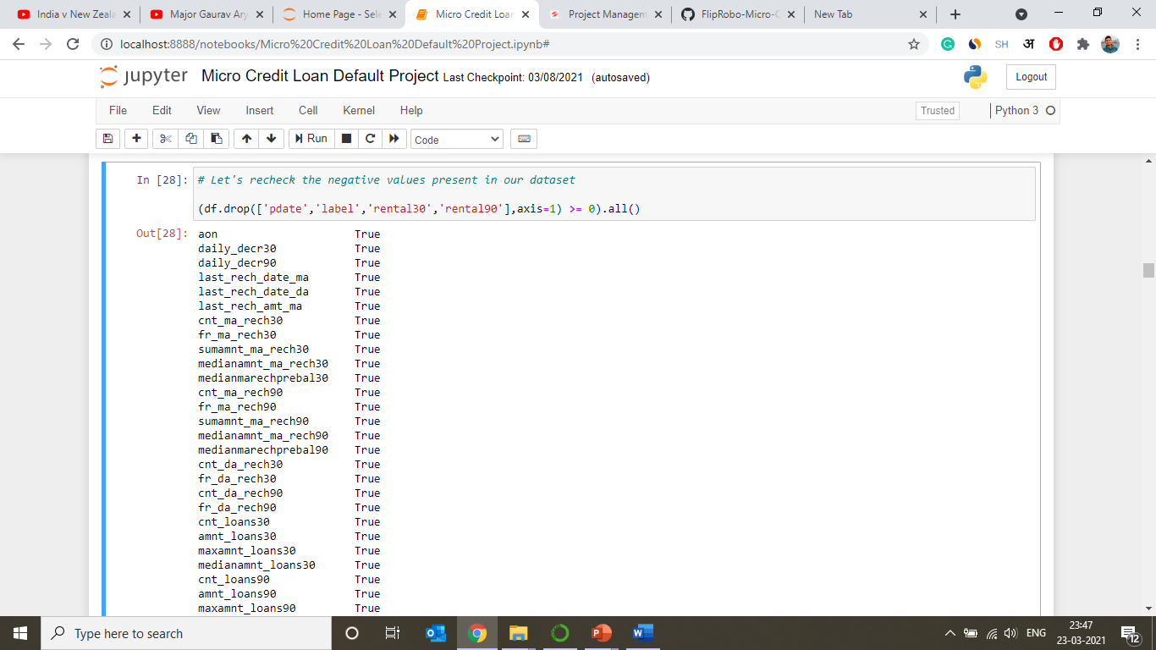

Slide 11
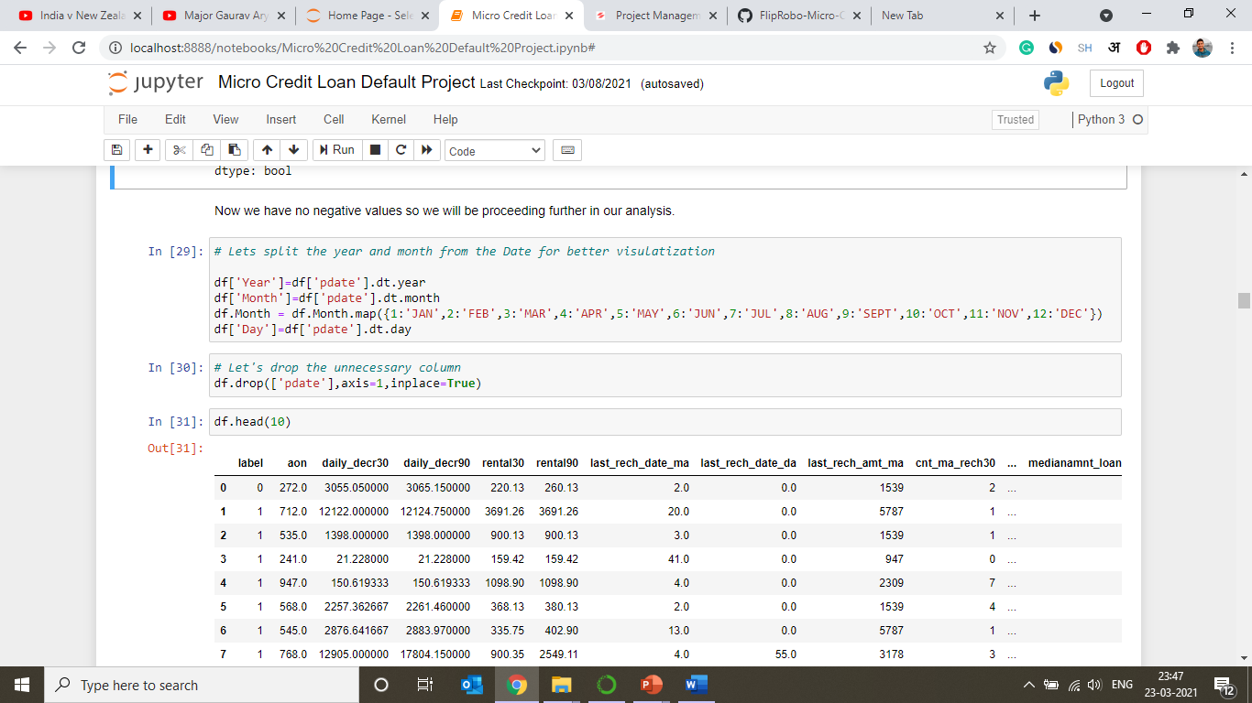
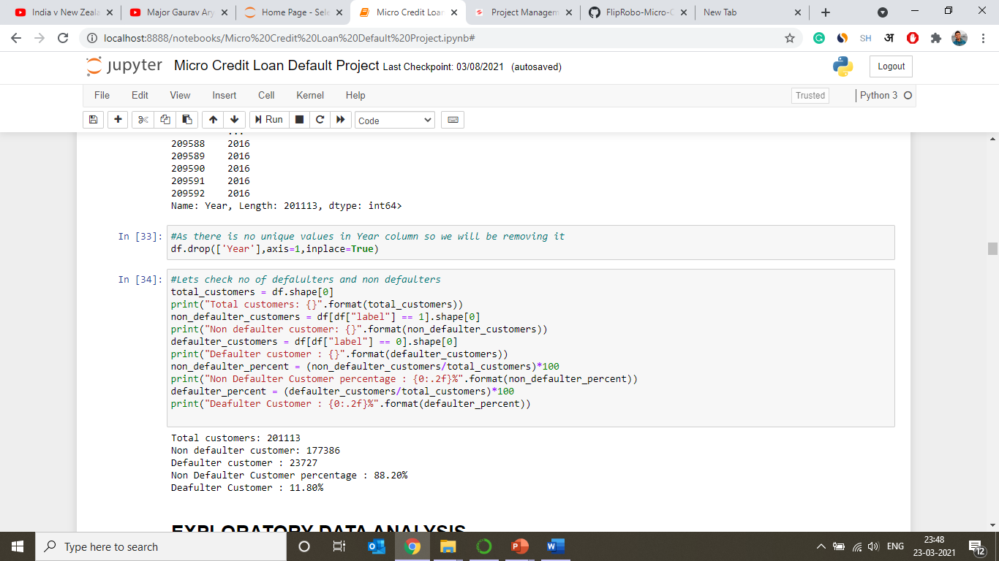

Slide 12
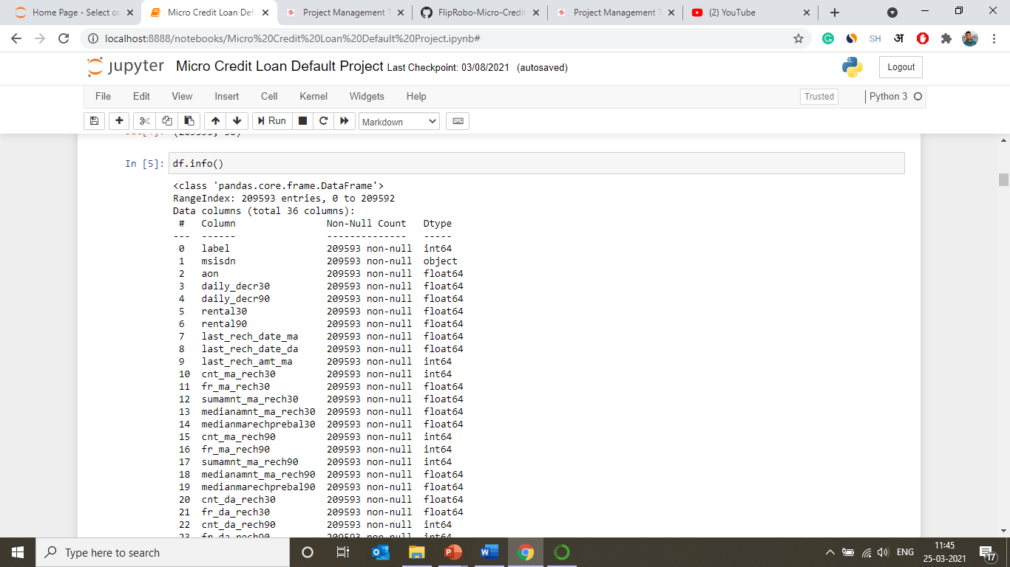
Data Analysis & Visualization

Slide 13
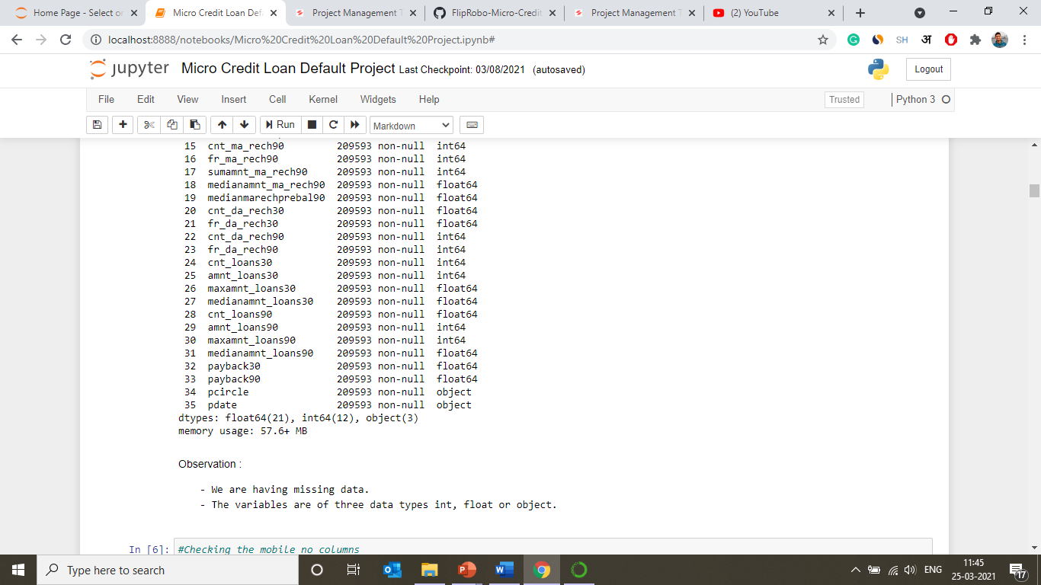

Slide 14
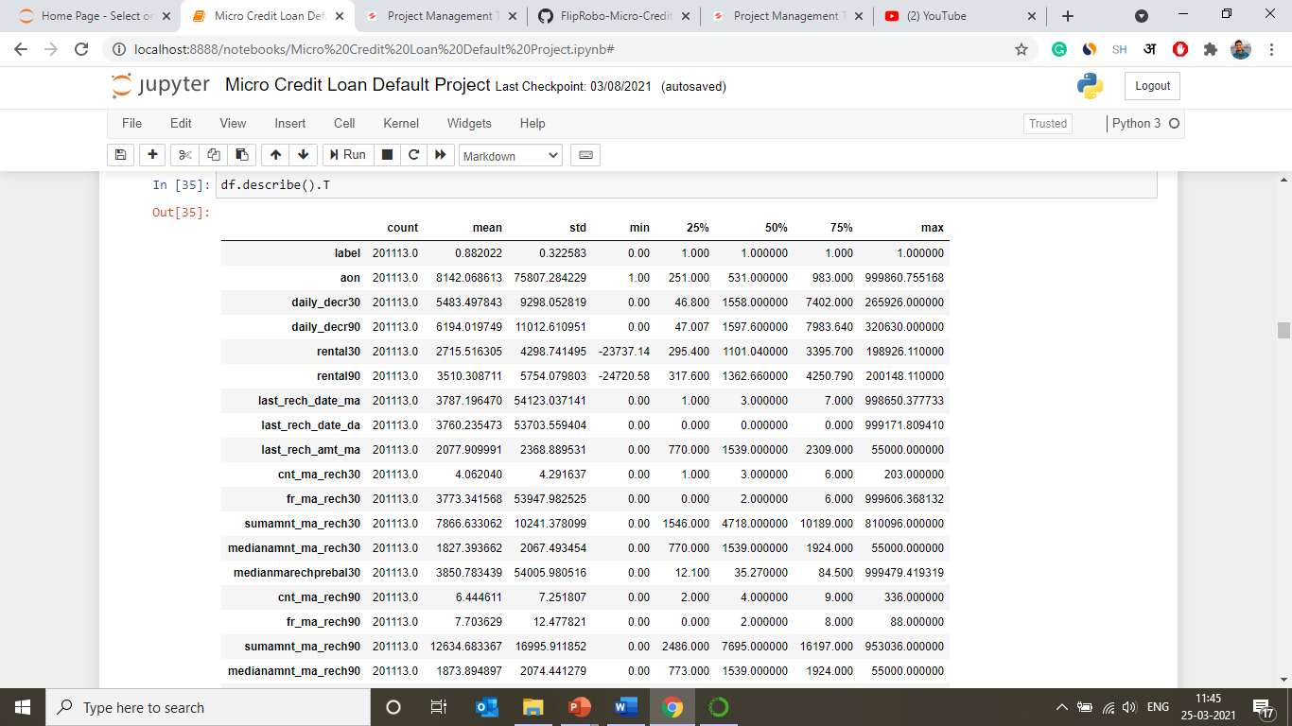

Slide 15
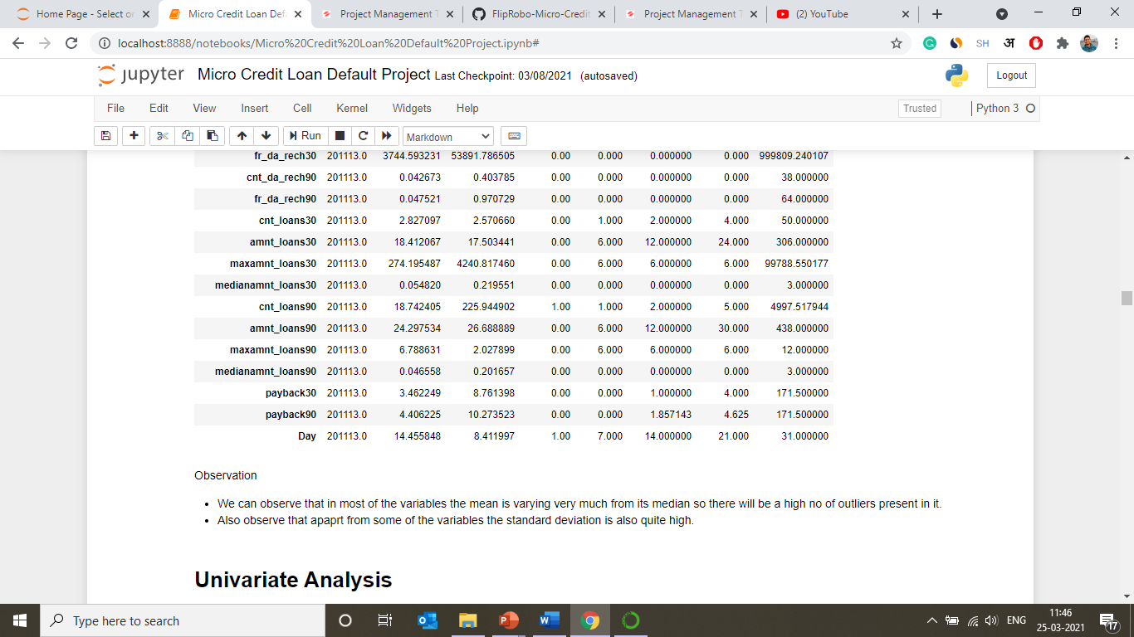

Slide 16
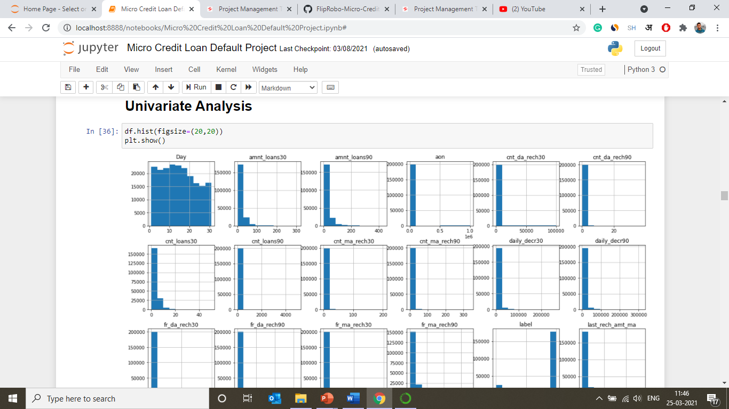

Slide 17
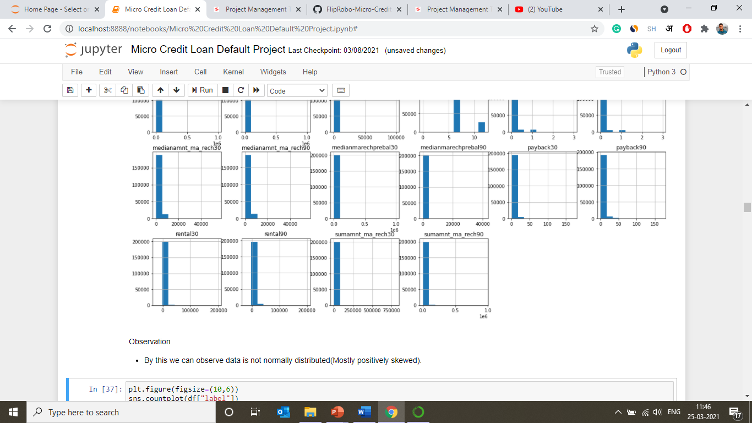

Slide 18
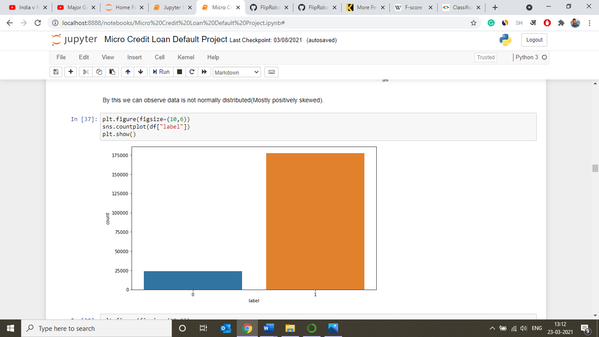
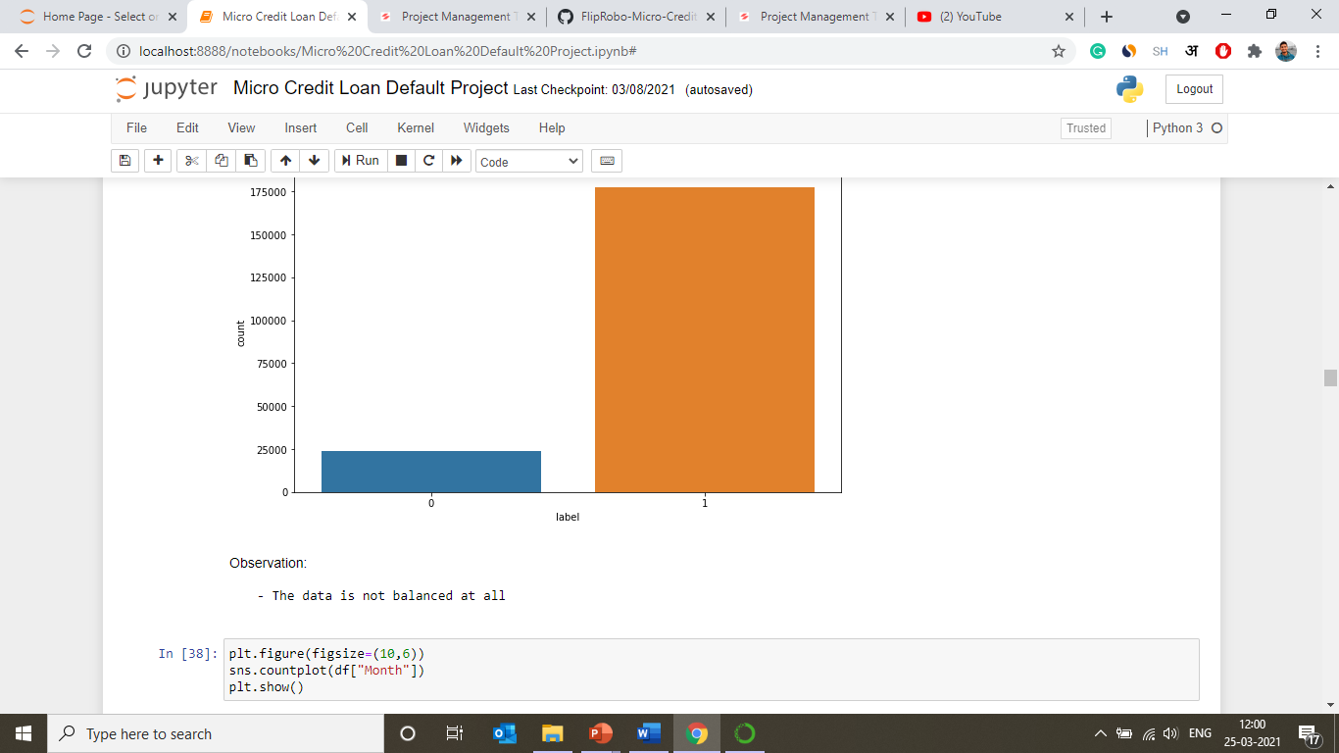

Slide 19
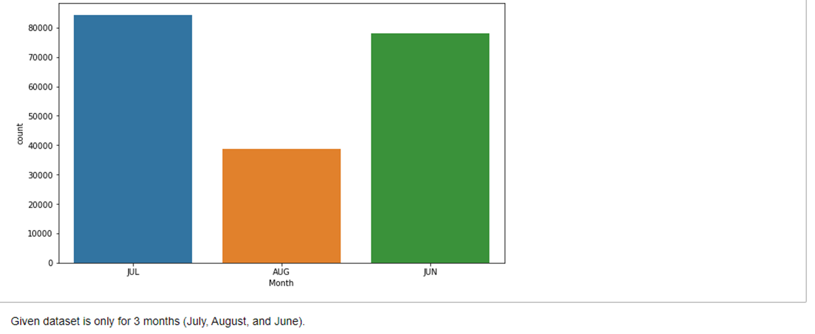

Slide 20
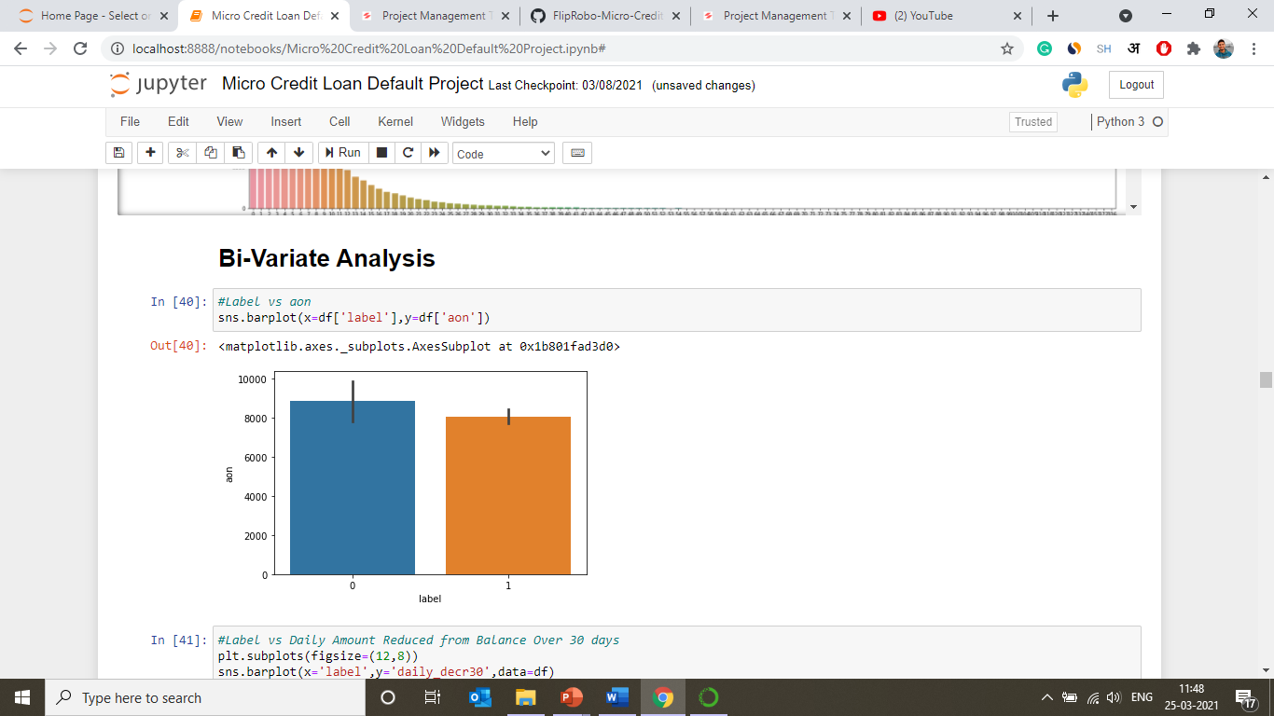

Slide 21
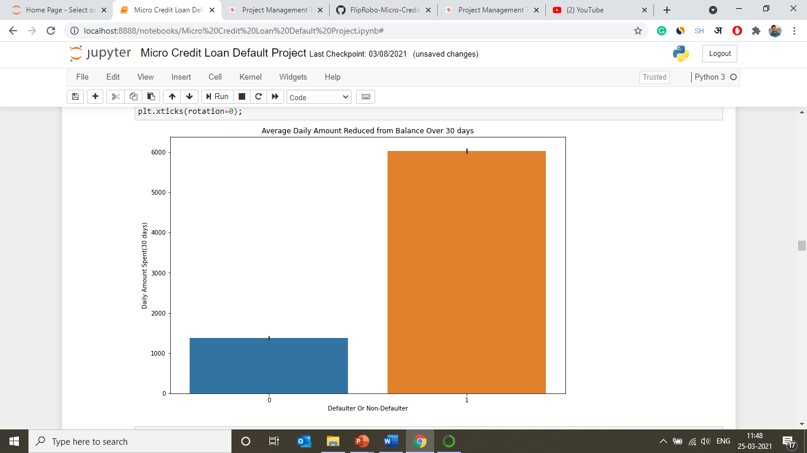

Slide 22
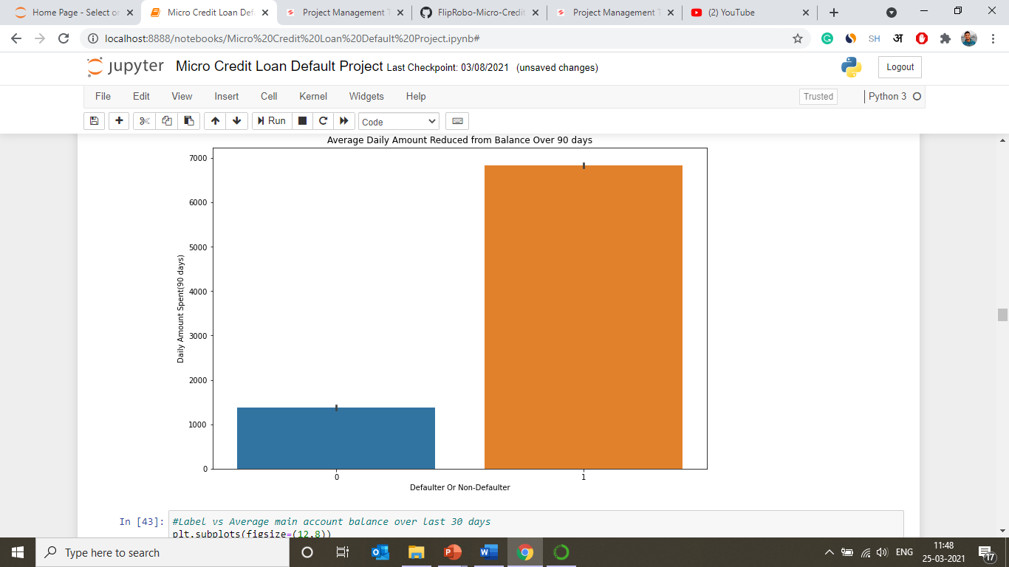

Slide 23
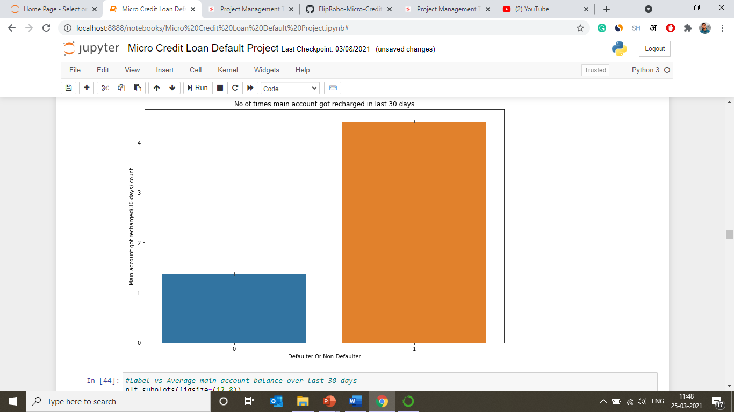

Slide 24
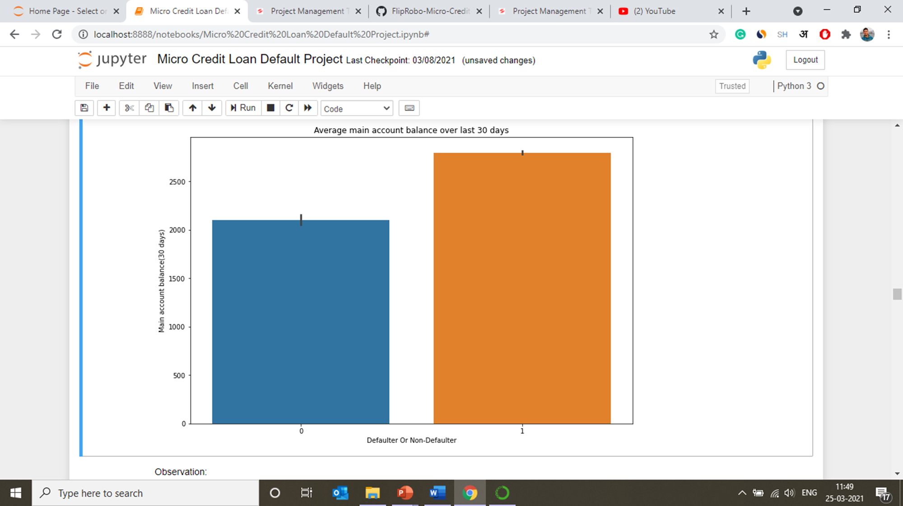

Slide 25
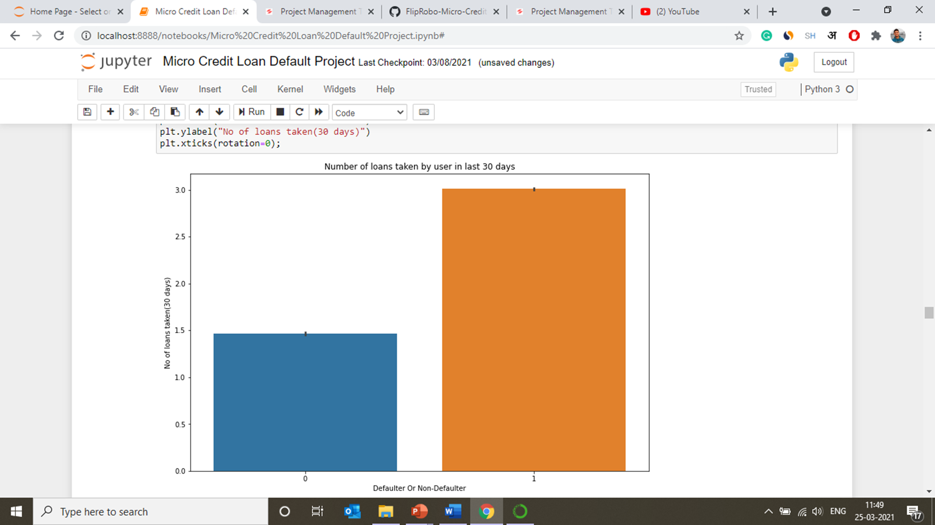
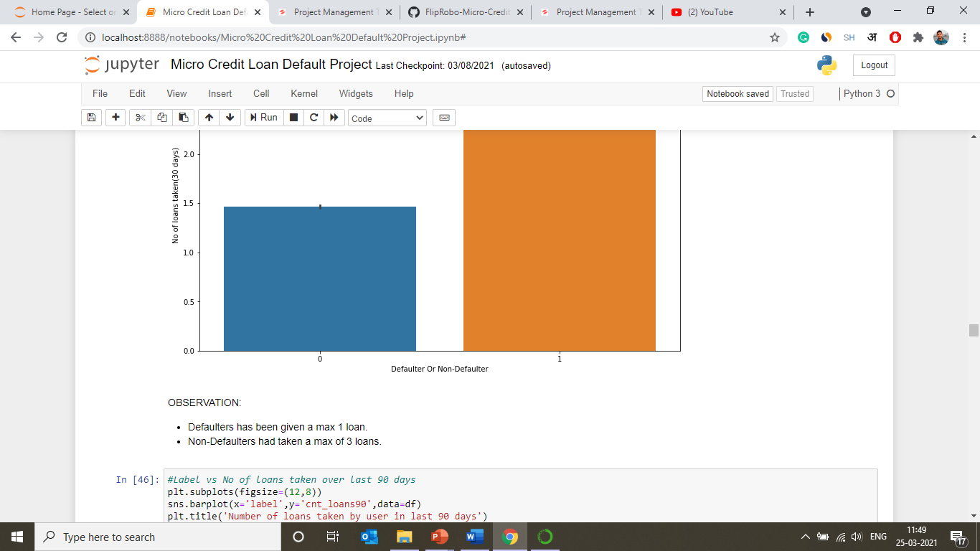

Slide 26
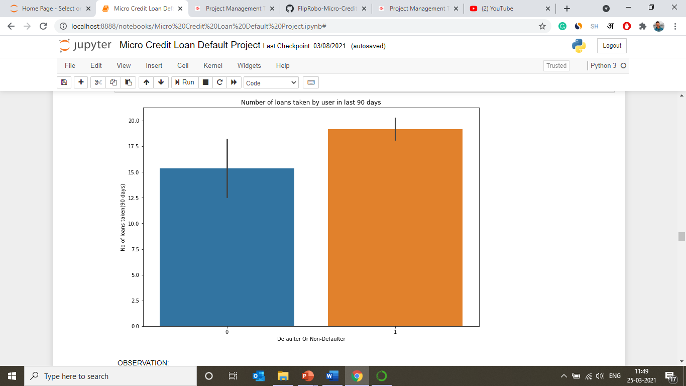
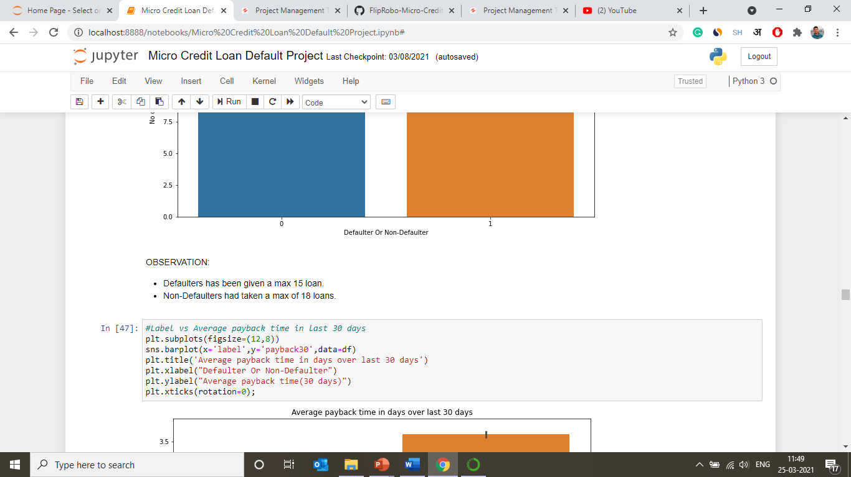

Slide 27
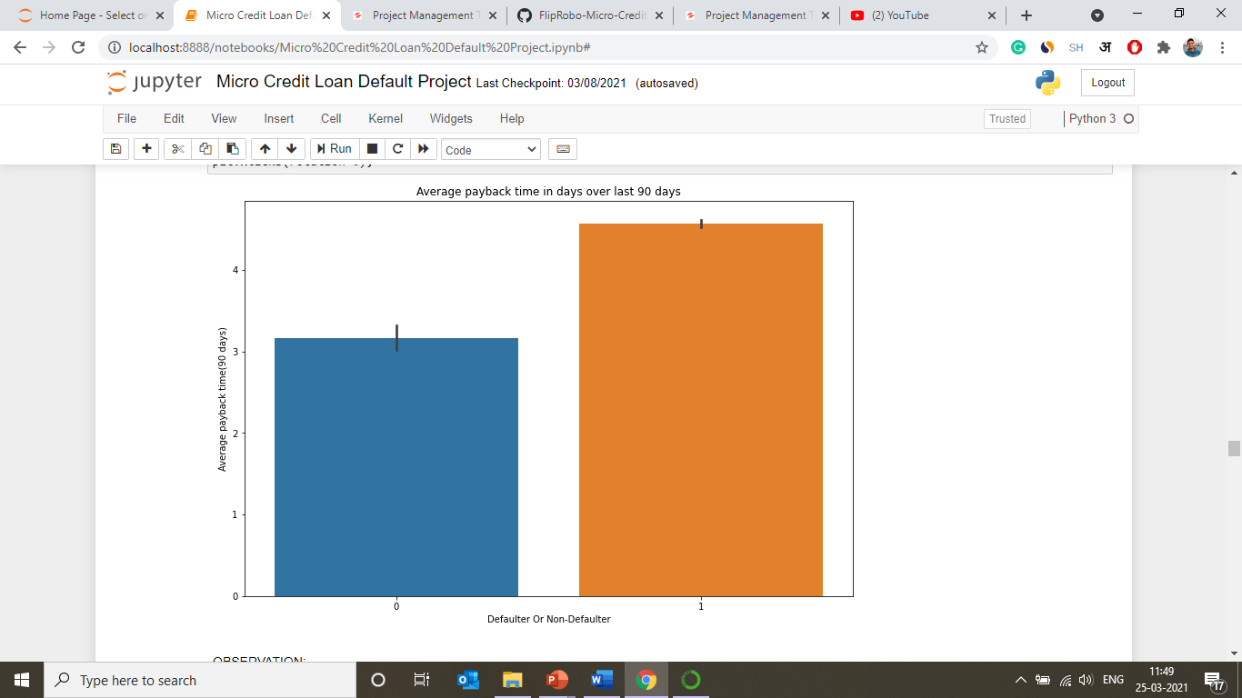
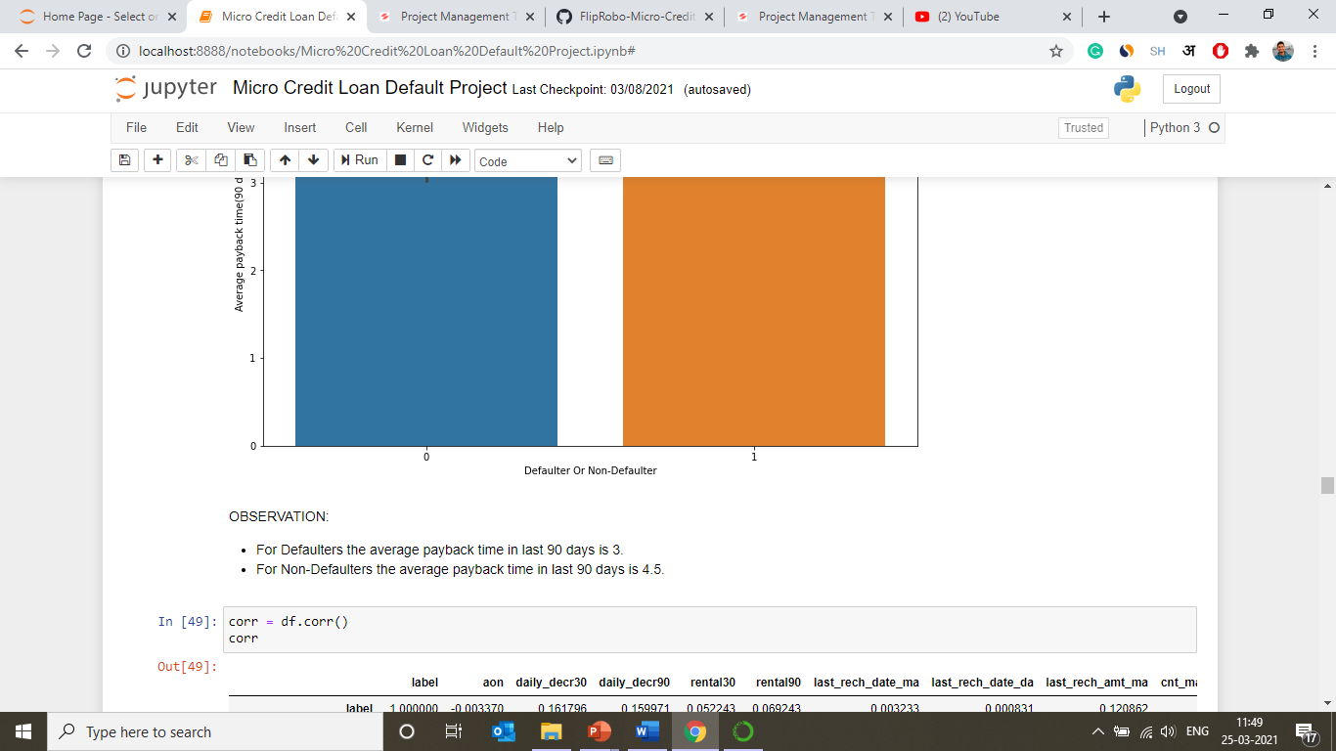

Slide 28
Correlations

Slide 29
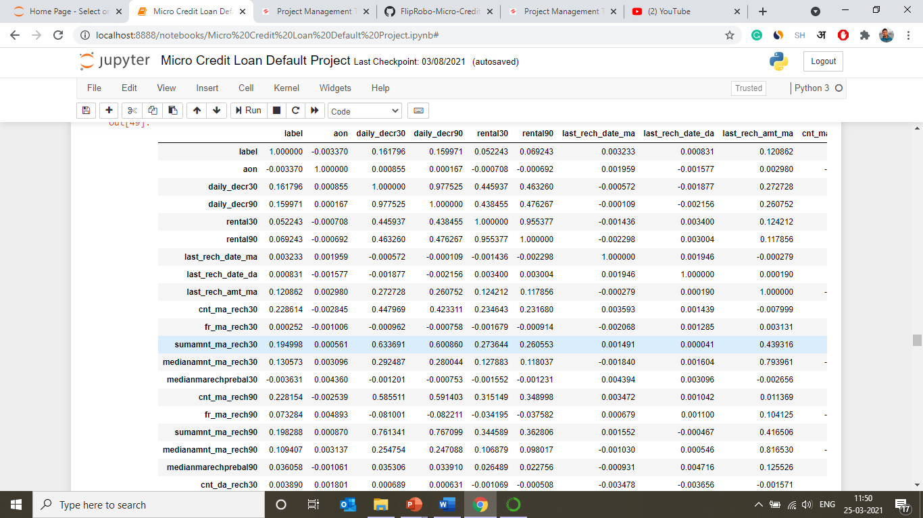
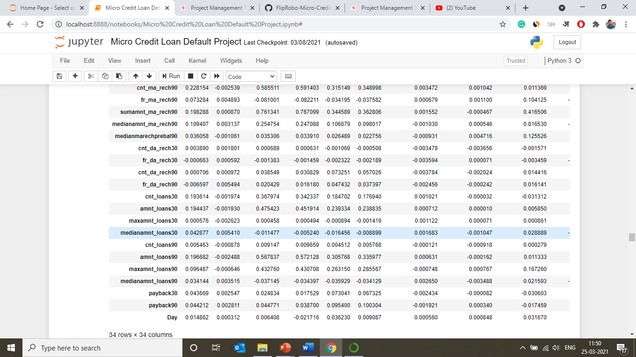

Slide 30
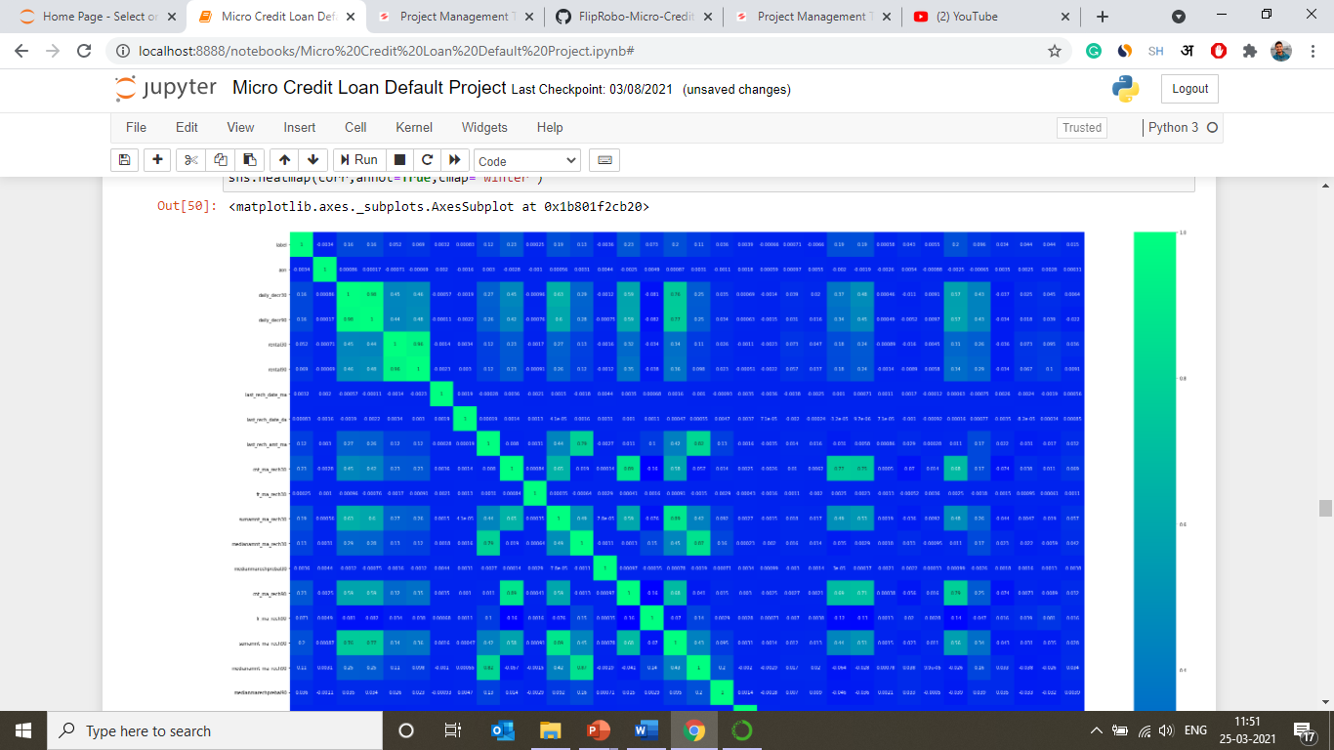

Slide 31
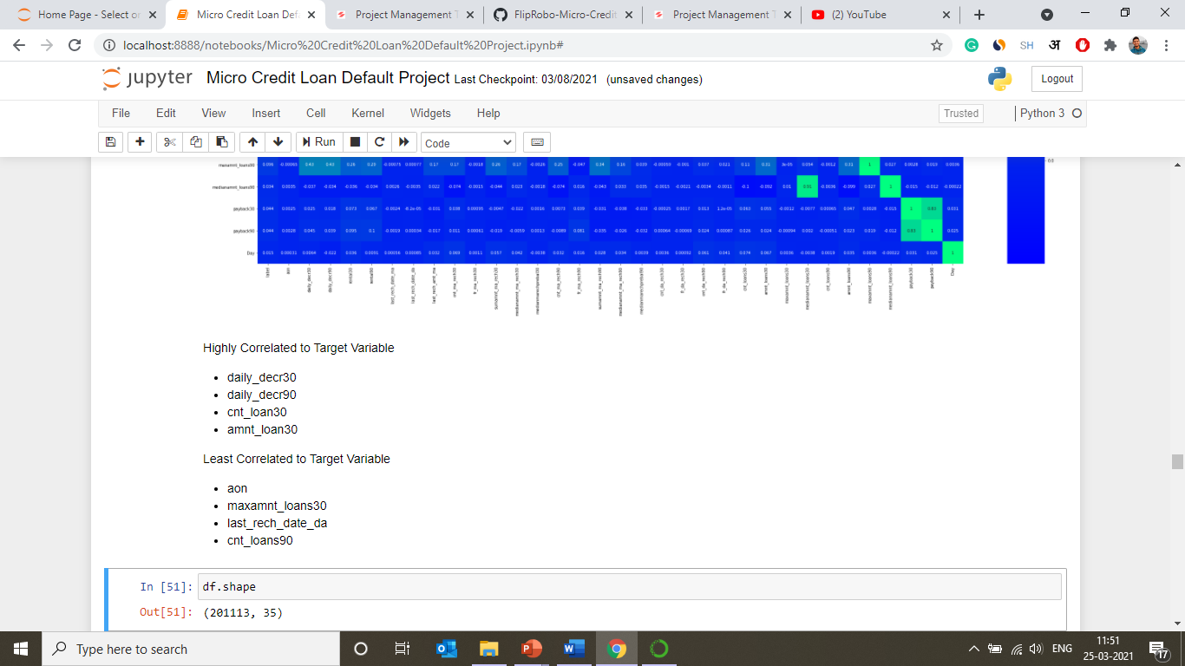

Slide 32
Plotting Outliers

Slide 33
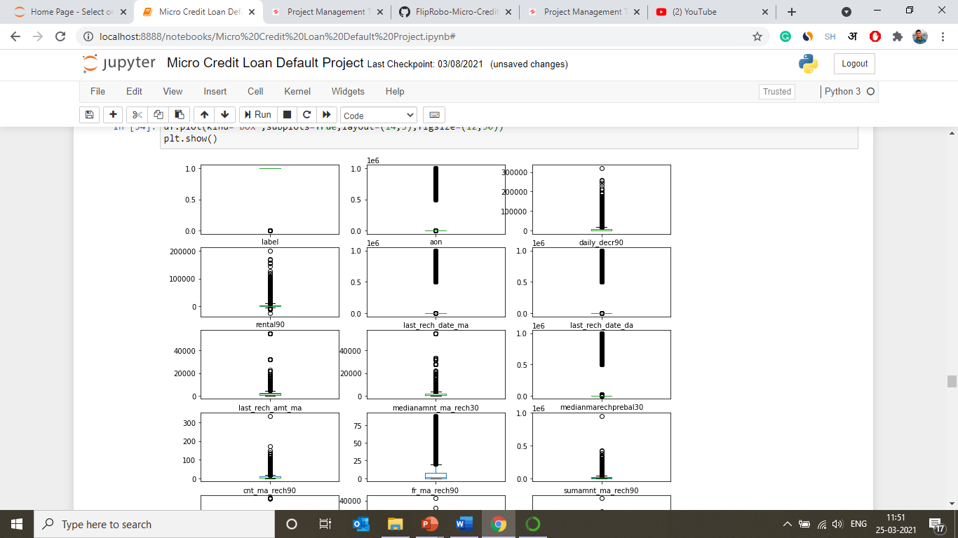

Slide 34
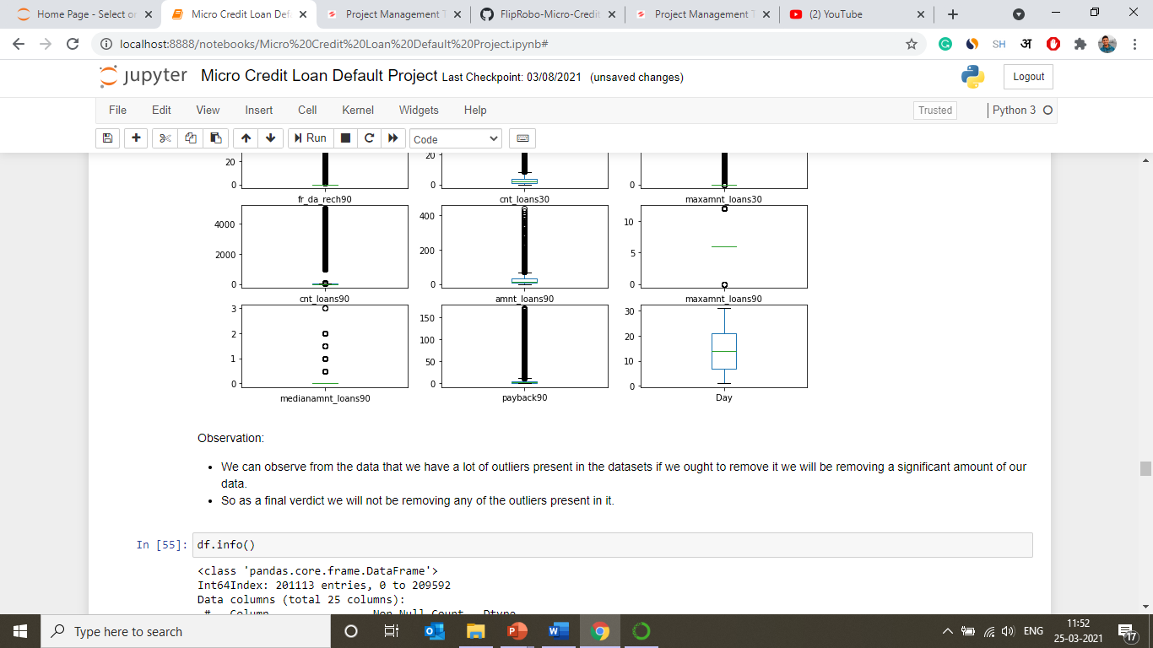

Slide 35
Model Pre-Proecessing

Slide 36
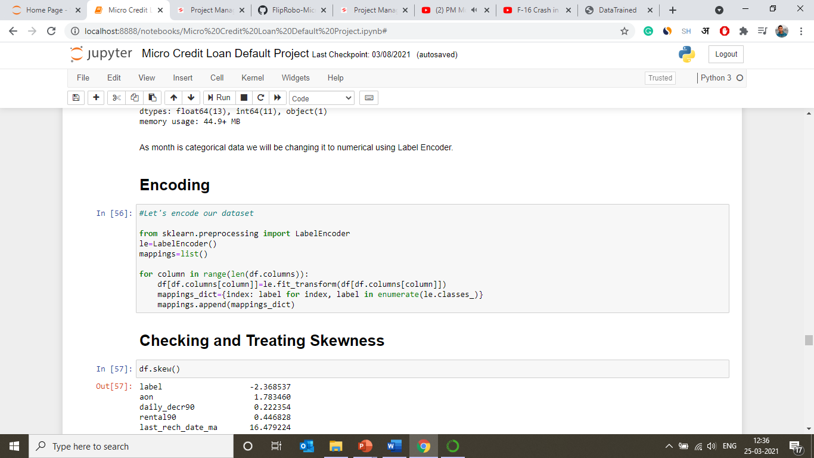
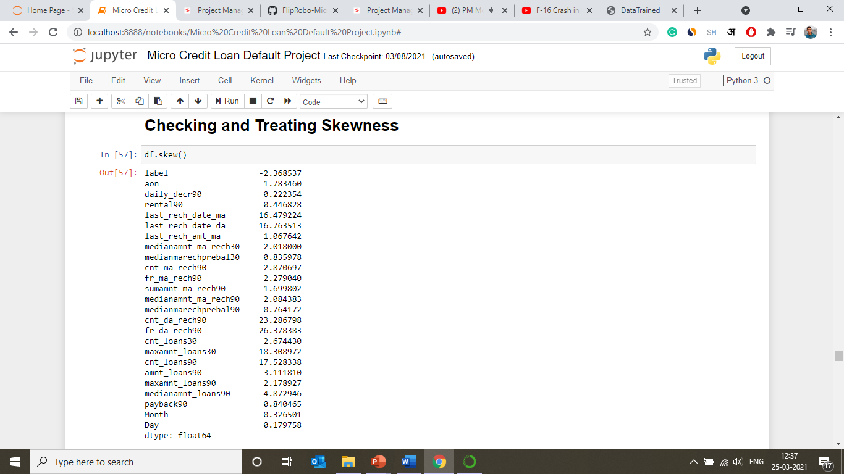

Slide 37
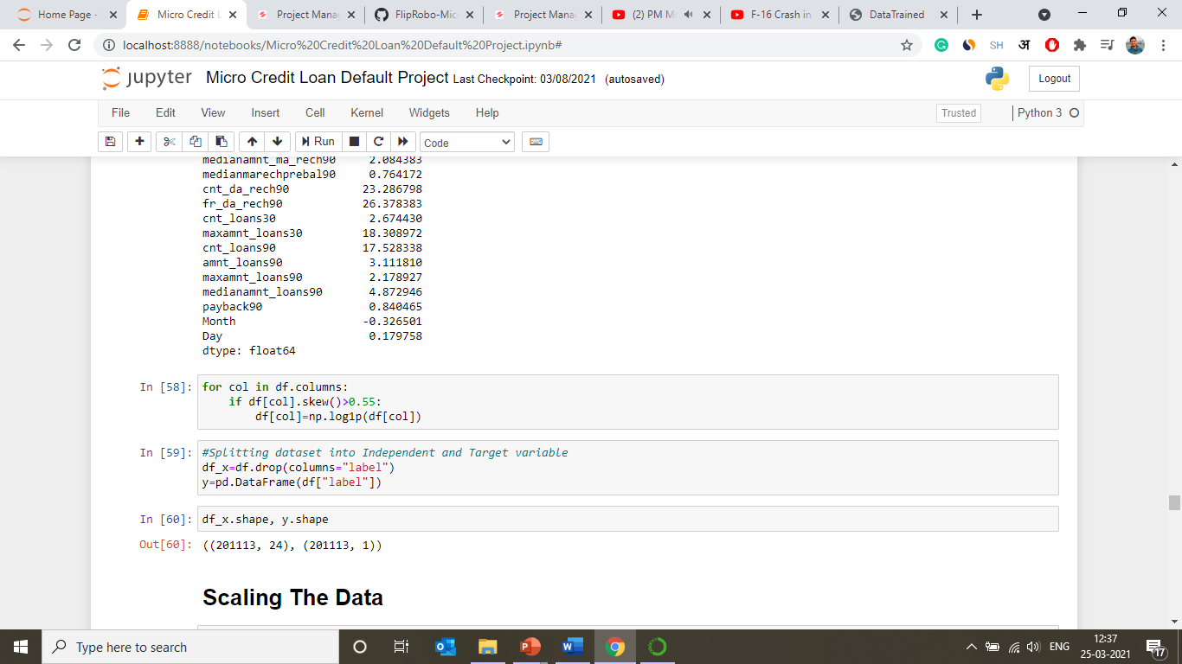
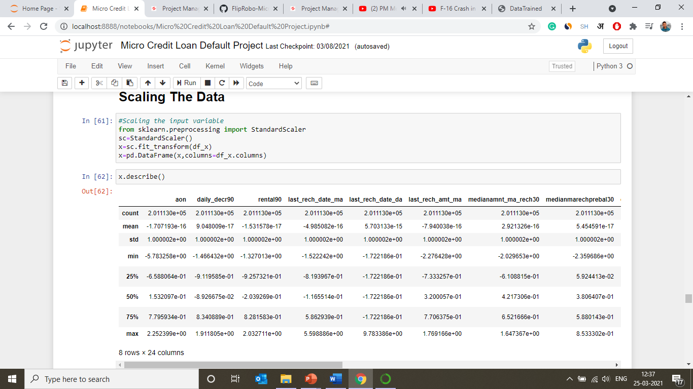

Slide 38
Model Building, Development and Evaluation

Slide 39
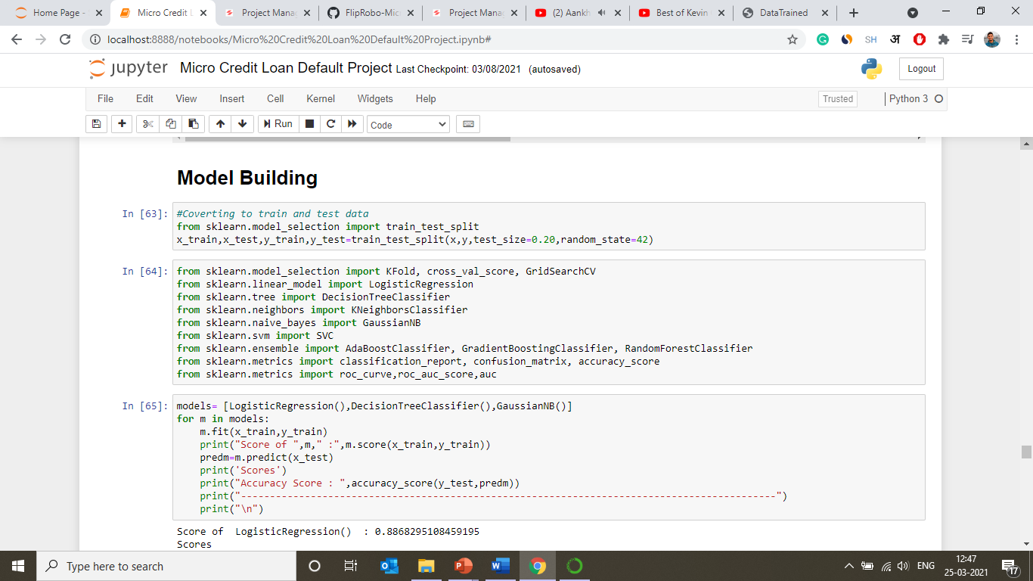

Slide 40
In this analysis, we have used three algorithms and three ensemble techniques to boost the predictive scores for better results. With the help of this approach, we will be able to successfully micro credit loan repayment predictions.
ALGORITHM USED:
Logistic Regression
Decision Tree Classifier
GaussianNB
ENSEMBLE TECHNIQUE USED:
Gradient Boosting Classifier
AdaBoost Classifier
Extra Trees Classifier
We ran these algorithms in order to find best fitting model and best accuracy and other different parameters.

Slide 41
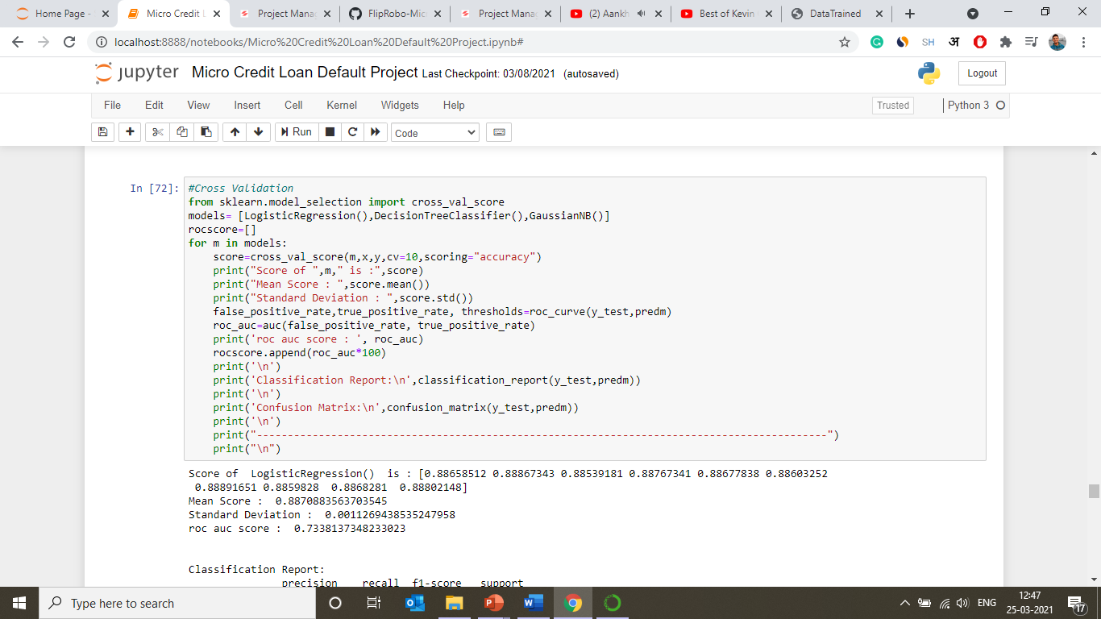

Slide 42
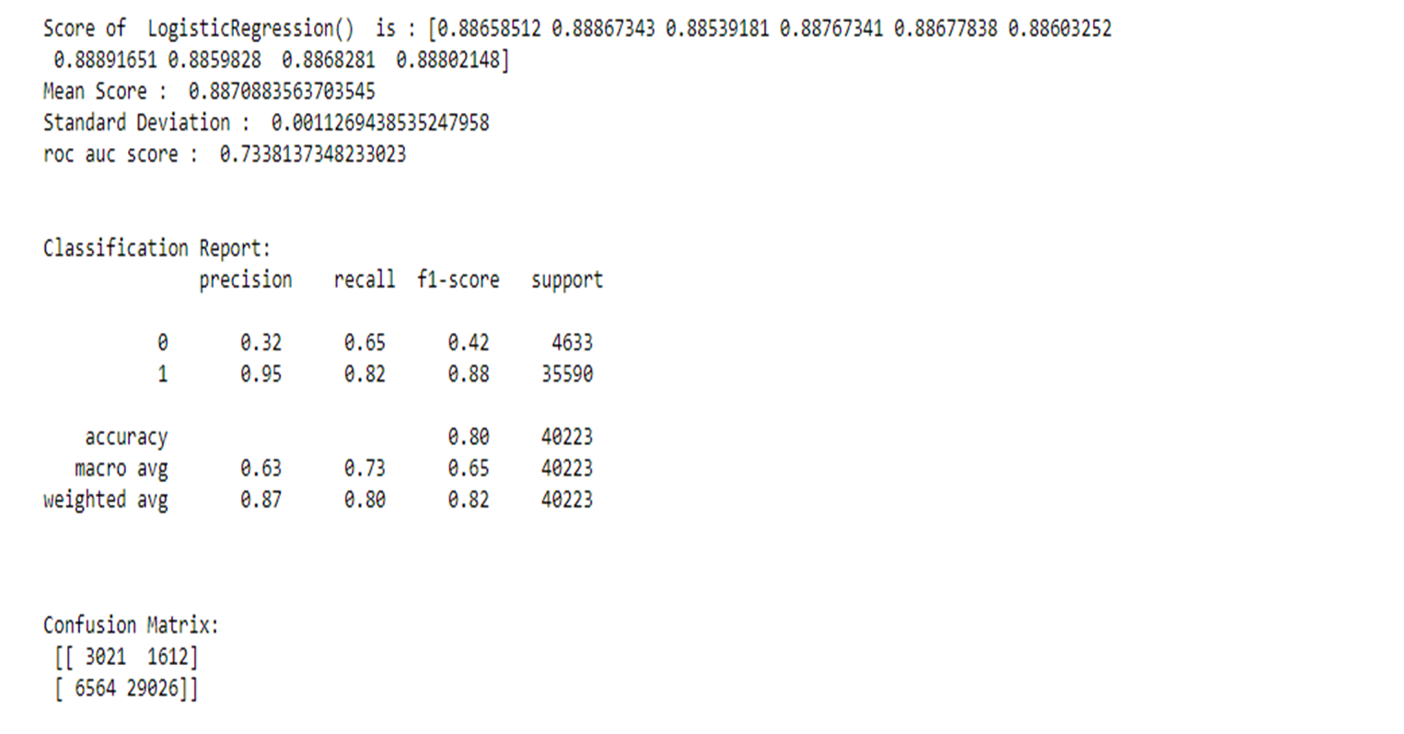
Scores for Logistic Regression

Slide 43
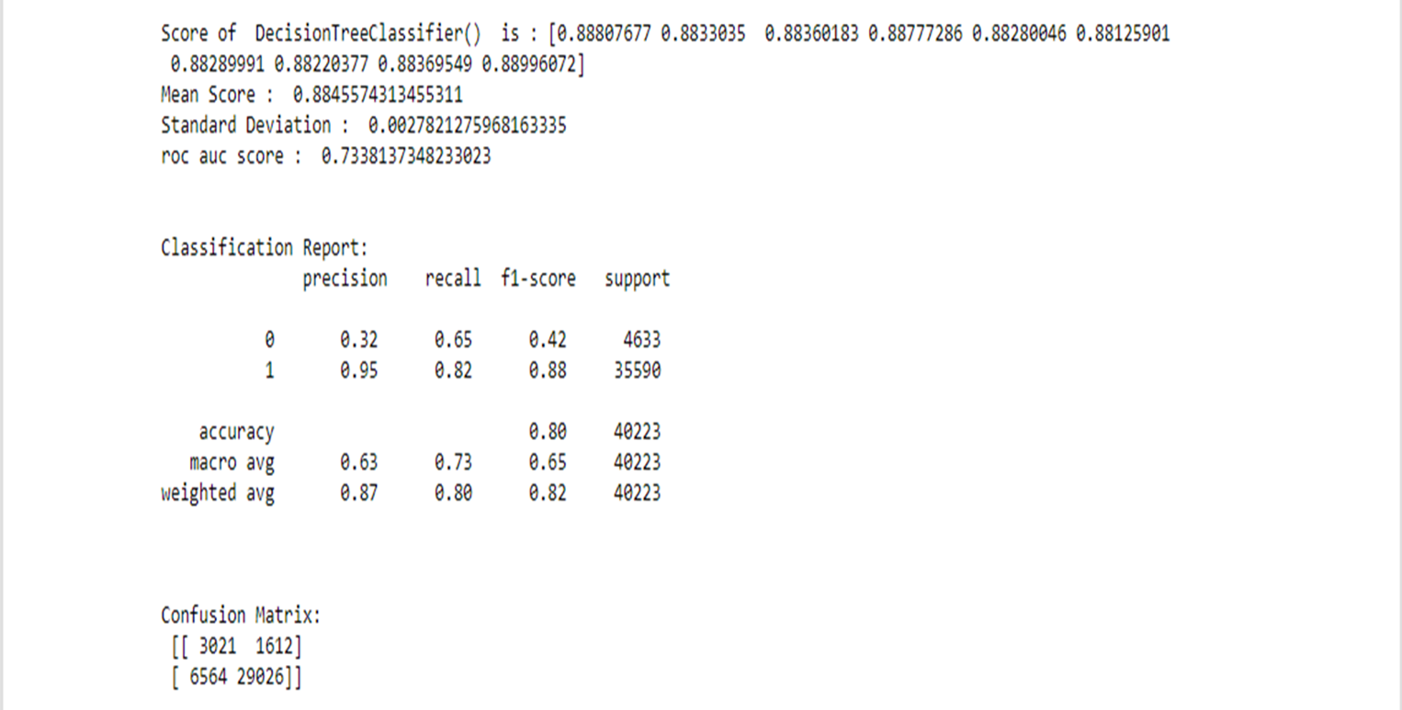
Scores for DecisionTree Classifier

Slide 44
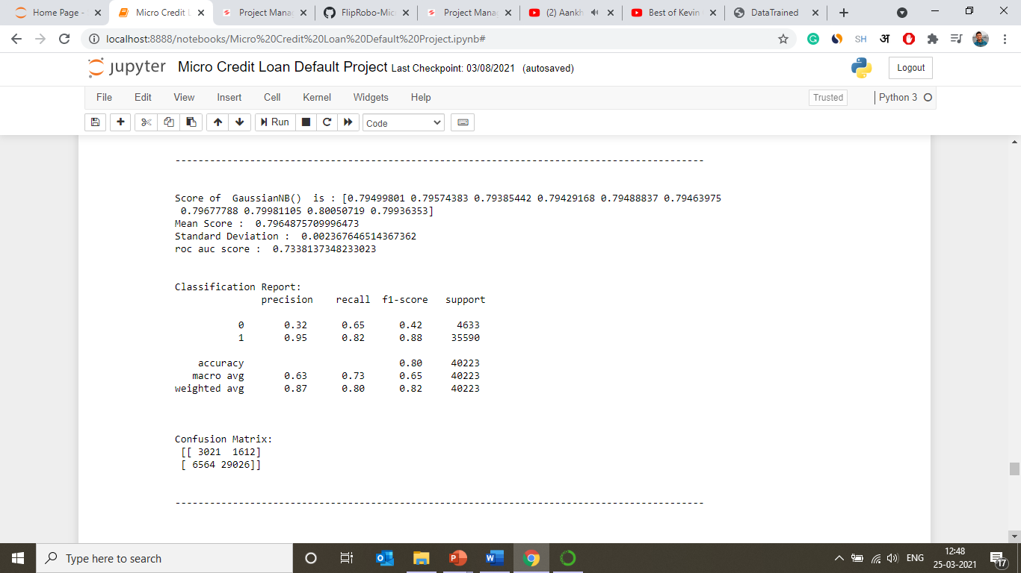
Scores for DecisionTree Classifier

Slide 45
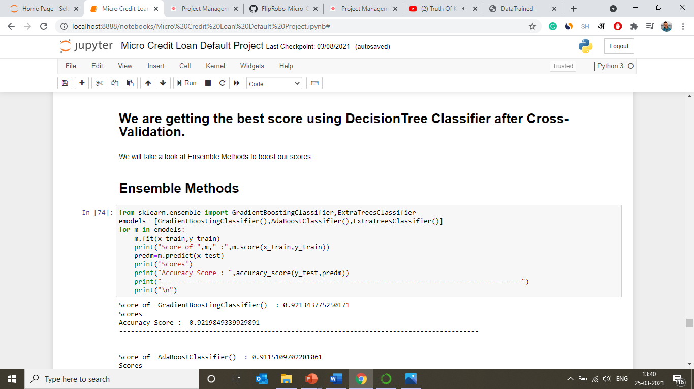

Slide 46
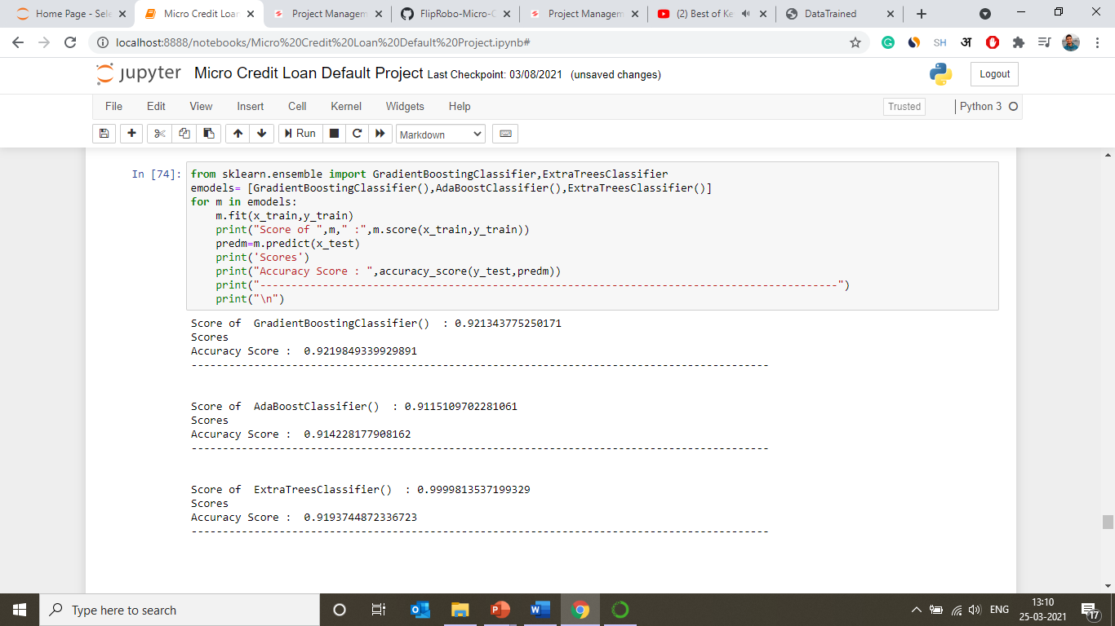
Scores for GradientBoosting, AdaBoost and ExtraTrees Classifier

Slide 47
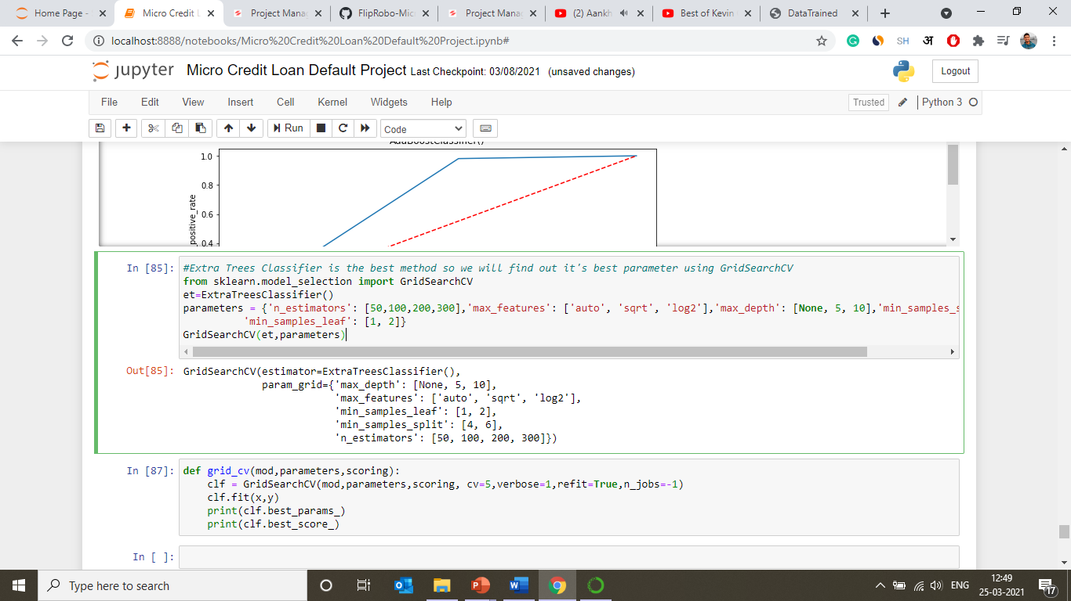
Choosing And Fitting Best Model (Extra Trees Classifer)

Slide 48
Summary Of Result of Best-fitted Model

Slide 49
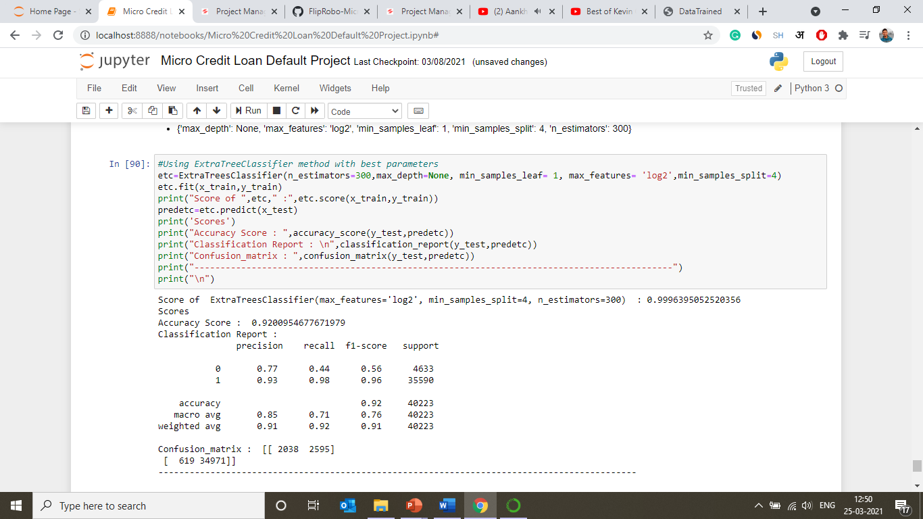

Slide 50


Slide 51


Slide 52

Saving The Model

